Slide 1
Comprehensive Workforce Analytics Dashboard
Anudip
Name : K.Nagamani
Course: Data Analytics
Batch No: C8713
Notes:
overview

Slide 2
Agenda
How many people in each department
Gender distribution by department
Age spread of staff
Min/Max/Average salary
Top earners in each country
Company growth trend
Employee filter(by starting letter)
India vs. New Zealand –quick scorecard

Slide 3
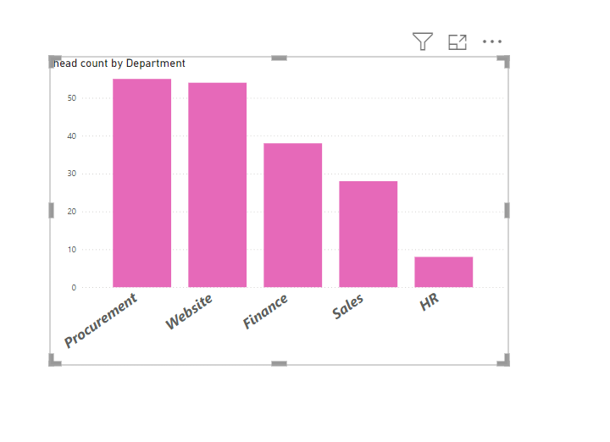
Department Headcount Overview
This bar chart displays the number of employees( headcount) in each department.
The departments shown include Procurement, Website, Finance, Sales, and HR.
Procurement and Website departments have the highest headcount, with Over 50 employees each

Slide 4
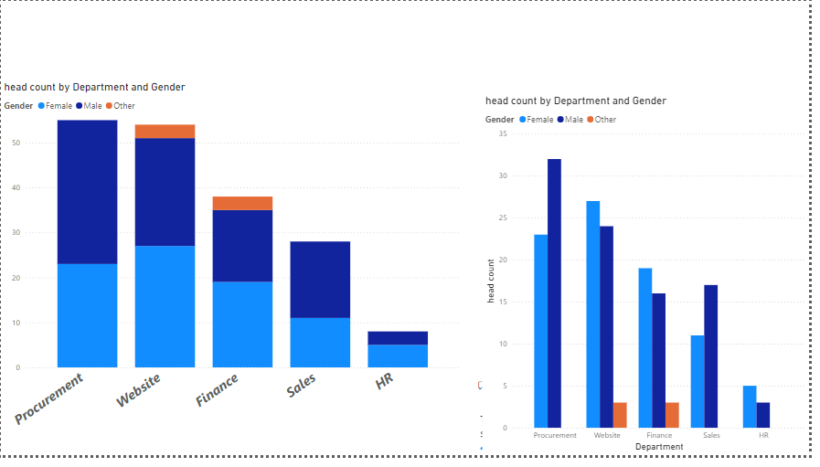
Department Headcount by Gender
These are two bar charts represent headcount distribution across departments, segmented by gender categories: Female, Male, and Other.
Each bar color represents a different gender: blue for Female, dark blue for male and orange for Other
Procurement and Website departments show a nearly balanced headcount between Male and Female employees, With a small representation of Other

Slide 5
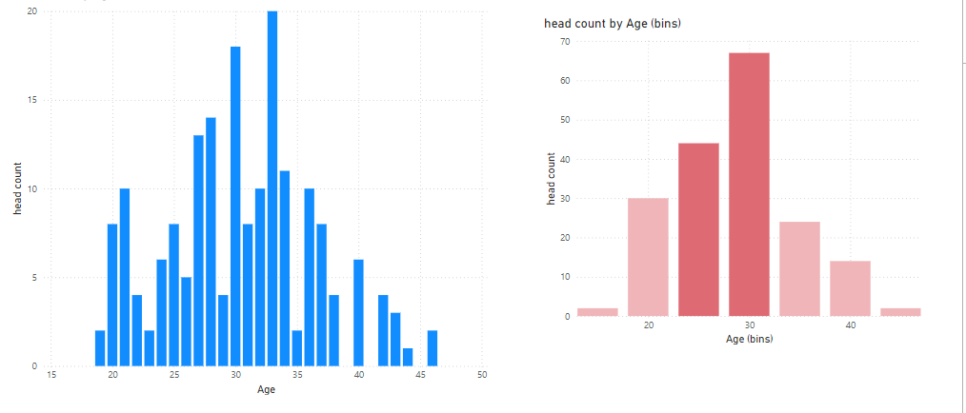
Age Distribution of Employees
This histogram displays the age distribution of employees within the organization.
The X-axis represents age groups, while the y-axis represents the number of employees (headcount)in each age group
This bar chart shows the headcount distribution across various age bins.

Slide 6
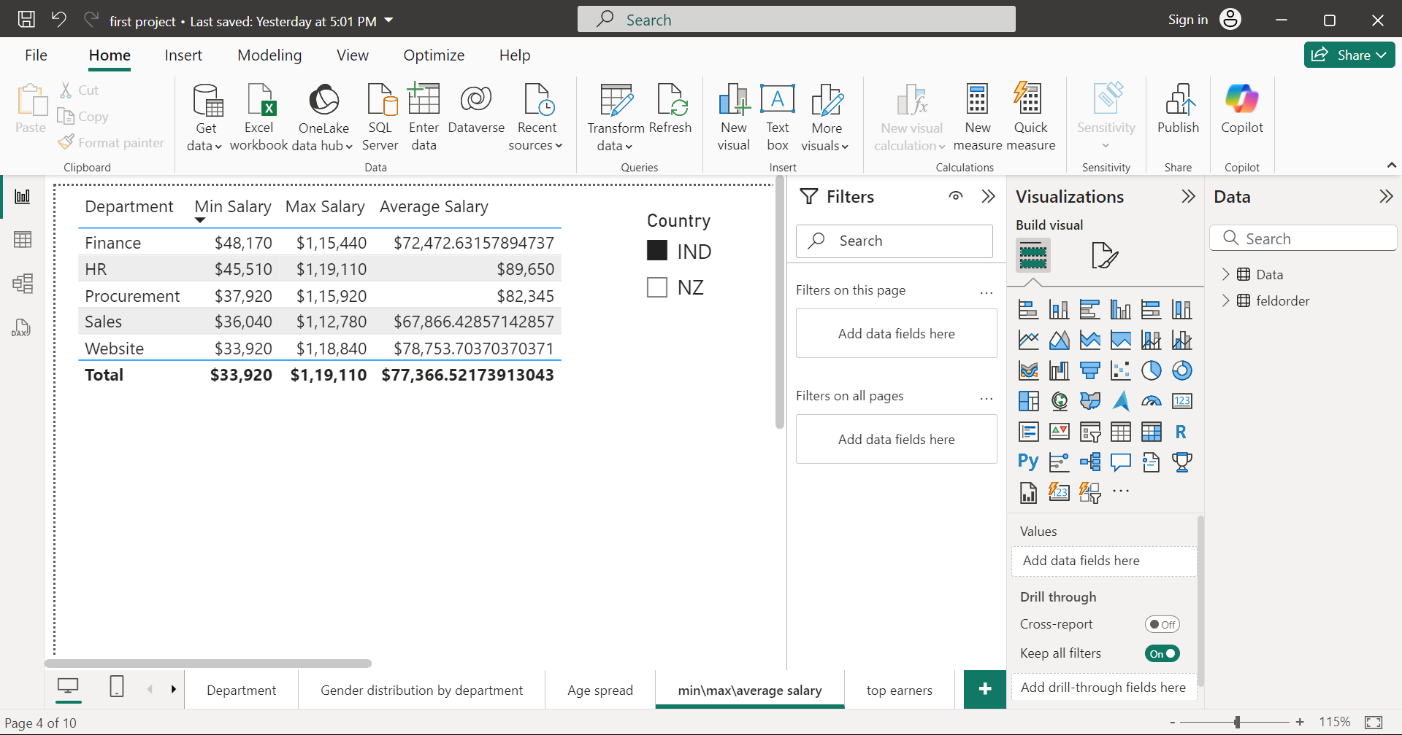
Salary Distribution by Department
This table presents the minimum, maximum, and average salaries across different departments within the organization.
The departments listed are finance, HR, procurement, sales, and website.
At the bottom , the total row displays the overall minimum, maximum, and average salary across a departments.

Slide 7
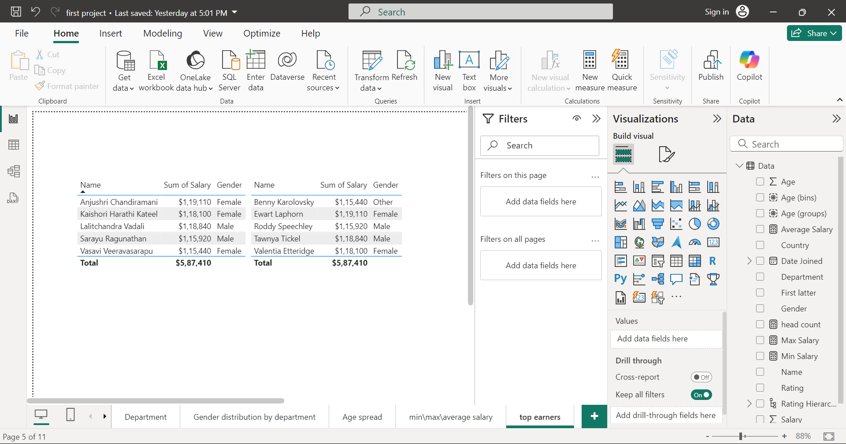
Top five employees in each country
This tables presents the top five employees Names, Salary and Gender in two country’s India and New Zealand

